Slide 1

Into the air
A loudspeaker vibrates and makes a sound.
We hear the sound because it moves through the air.

Slide 2
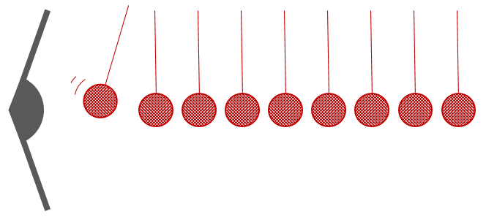
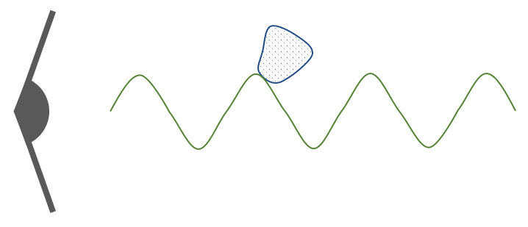


Into the air
These pictures try to show how sound moves through the air.
Which one is the best model for how sound moves?
A
B
C
D

